Slide 1
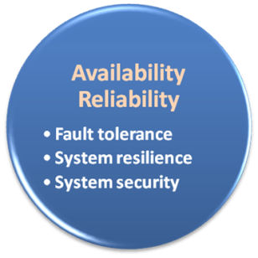

Availability & Reliability
Data Never Loss Machine Never Fail

Slide 2
Availability & Reliability
What is availability ?
The degree to which a system, subsystem, or equipment is in a specified operable and committable state at the start of a mission, when the mission is called for at an unknown time.
Cloud system usually require high availability
Ex. “Five Nines” system would statistically provide 99.999% availability
What is reliability ?
The ability of a system or component to perform its required functions under stated conditions for a specified period of time.
But how to achieve these properties ?
Fault tolerance system
Require system resilience
Reliable system security

Slide 3
Fault Tolerance
What is fault tolerant system ?
Fault-tolerance is the property that enables a system to continue operating properly in the event of the failure of some of its components.
If its operating quality decreases at all, the decrease is proportional to the severity of the failure, as compared to a naively-designed system in which even a small failure can cause total breakdown.
Four basic characteristics :
No single point of failure
Fault detection and isolation to the failing component
Fault containment to prevent propagation of the failure
Availability of reversion modes

Slide 4

Fault Tolerance
Single Point Of Failure (SPOF)
A part of a system which, if it fails, will stop the entire system from working.
The assessment of a potentially single location of failure identifies the critical components of a complex system that would provoke a total systems failure in case of malfunction.
Preventing single point of failure
If a system experiences a failure, it must continue to operate without interruption during the repair process.

Slide 5

Fault Tolerance
Fault Detection and Isolation (FDI)
A subfield of control engineering which concerns itself with monitoring a system, identifying when a fault has occurred and pinpoint the type of fault and its location.
Isolate failing component
When a failure occurs, the system must be able to isolate the failure to the offending component.

Slide 6
Fault Tolerance
Fault Containment
Some failure mechanisms can cause a system to fail by propagating the failure to the rest of the system.
Mechanisms that isolate a rogue transmitter or failing component to protect the system are required.
Available of reversion modes
System should be able to maintain some check points which can be used in managing the state changes.

Slide 7
System Resilience
What is resilience ?
Resilience is the ability to provide and maintain an acceptable level of service in the face of faults and challenges to normal operation.
Resiliency pertains to the system's ability to return to its original state after encountering trouble. In other words, if a risk event knocks a system offline, a highly resilient system will return back to work and function as planned as soon as possible.
Some risk events
If power is lost at a plant for two days, can our system recover ?
If a key service is lost because a database corruption, can the business recover ?

Slide 8
System Resilience
Disaster Recovery
Disaster recovery is the process, policies and procedures related to preparing for recovery or continuation of technology infrastructure critical to an organization after a natural or human-induced disaster.
Some common strategies :
Backup
Make data off-site at regular interval
Replicate data to an off-site location
Replicate whole system
Preparing
Local mirror systems
Surge protector
Uninterruptible Power Supply (UPS)

Slide 9
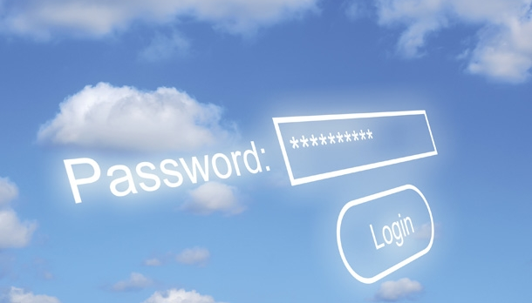
System Security
Security issue in Cloud Computing :
Cloud security is an evolving sub-domain of computer security, network security, and, more broadly, information security.
It refers to a broad set of policies, technologies, and controls deployed to protect data, applications, and the associated infrastructure of cloud computing.

Slide 10
System Security
Important security and privacy issues :
Data Protection
To be considered protected, data from one customer must be properly segregated from that of another.
Identity Management
Every enterprise will have its own identity management system to control access to information and computing resources.
Application Security
Cloud providers should ensure that applications available as a service via the cloud are secure.
Privacy
Providers ensure that all critical data are masked and that only authorized users have access to data in its entirety.

Slide 11
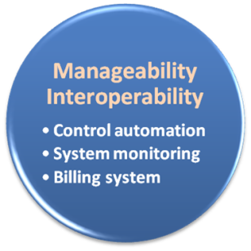

Manageability & Interoperability
I Want Full Control !!

Slide 12
Manageability & Interoperability
What is manageability ?
Enterprise-wide administration of cloud computing systems. Systems manageability is strongly influenced by network management initiatives in telecommunications.
What is interoperability ?
Interoperability is a property of a product or system, whose interfaces are completely understood, to work with other products or systems, present or future, without any restricted access or implementation.
But how to achieve these properties ?
System control automation
System state monitoring

Slide 13
Control Automation
What is Autonomic Computing ?
Its ultimate aim is to develop computer systems capable of self-management, to overcome the rapidly growing complexity of computing systems management, and to reduce the barrier that complexity poses to further growth.
Architectural framework :
Composed by Autonomic Components (AC) which will interact with each other.
An AC can be modeled in terms of two main control loops (local and global) with sensors (for self-monitoring), effectors (for self-adjustment), knowledge and planer/adapter for exploiting policies based on self- and environment awareness.

Slide 14
Control Automation
Four functional areas :
Self-Configuration
Automatic configuration of components.
Self-Healing
Automatic discovery, and correction of faults.
Self-Optimization
Automatic monitoring and control of resources to ensure the optimal functioning with respect to the defined requirements.
Self-Protection
Proactive identification and protection from arbitrary attacks.

Slide 15
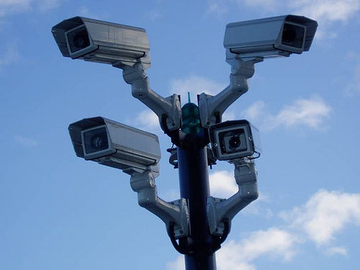
System Monitoring
What is system monitor ?
A System Monitor in systems engineering is a process within a distributed system for collecting and storing state data.
What should be monitored in the Cloud ?
Physical and virtual hardware state
Resource performance metrics
Network access patterns
System logs
… etc
Anything more ?
Billing system

Slide 16

Billing System
Billing System in Cloud
Users pay as many as they used.
Cloud provider must first determine the list of service usage price.
Cloud provider have to record the resource or service usage of each user, and then charge users by these records.
How can cloud provider know users’ usage ?
Get those information by means of monitoring system.
Automatically calculate the total amount of money which user should pay. And automatically request money from user’s banking account.

Slide 17
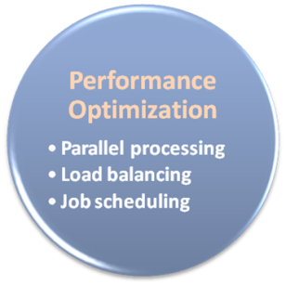

Performance & Optimization
High Performance Improvement

Slide 18
Performance & Optimization
Performance guarantees ??
As the great computing power in cloud, application performance should be guaranteed.
Cloud providers make use of powerful infrastructure or other underlining resources to build up a highly performed and highly optimized environment, and then deliver the complete services to cloud users.
But how to achieve this property ?
Parallel computing
Load balancing
Job scheduling

Slide 19
Parallel Processing
Parallel Processing
Parallel processing is a form of computation in which many calculations are carried out simultaneously, operating on the principle that large problems can often be divided into smaller ones, which are then solved concurrently.
Parallelism in different levels :
Bit level parallelism
Instruction level parallelism
Data level parallelism
Task level parallelism

Slide 20
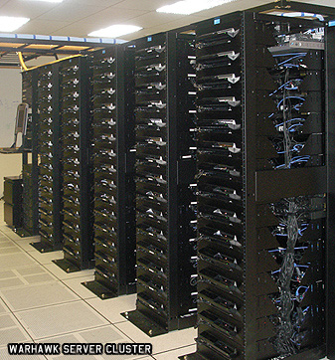
Parallel Processing
Hardware approaches
Multi-core computer
Symmetric multi-processor
General purpose graphic processing unit
Vector processor
Distributed computing
Cluster computing
Grid computing
Software approaches
Parallel programming language
Automatic parallelization

Slide 21

Load Balancing
What is load balancing ?
Load balancing is a technique to distribute workload evenly across two or more computers, network links, CPUs, hard drives, or other resources, in order to get optimal resource utilization, maximize throughput, minimize response time, and avoid overload.
Why should be load balanced ?
Improve resource utilization
Improve system performance
Improve energy efficiency
Unbalanced

Slide 22
Job Scheduling
What is job scheduler ?
A job scheduler is a software application that is in charge of unattended background executions, commonly known for historical reasons as batch processing.
What should be scheduled in Cloud ?
Computation intensive tasks
Dynamic growing and shrinking tasks
Tasks with complex processing dependency
How to approach ?
Use pre-defined workflow
System automatic configuration

